Slide 1
Simple Machines
Simple Machine- a tool with few parts that makes it easier or possible to do work.
6 common simple machines
Lever
Pulley
Inclined Plane
Wedge
Screw
Wheel and Axle

Slide 2
Lever
Lever- a simple machine that makes it easier or possible to do work
Fulcrum- a fixed point around which a lever rotates.
Effort Force- The force applied to a machine by the user
Resistance Force- The force applied to a machine by the object to be moved

Slide 3
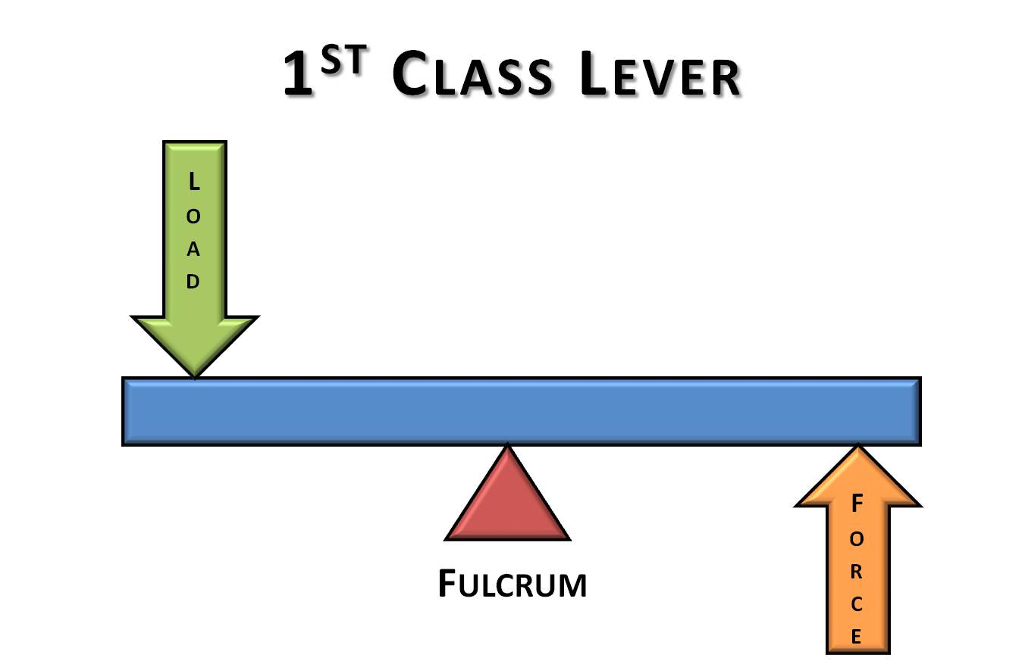
3 Classes of Levers
First- Class Lever
The Fulcrum is between the Effort and the Resistance
Changes the direction of the force
Increases the force

Slide 4
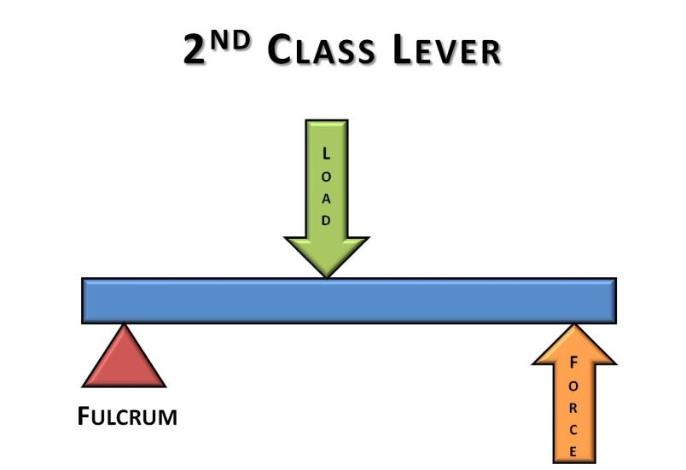
2nd Class Lever
The Resistance is positioned between the Effort and the Fulcrum.
Always increased the force
Do NOT change the direction of the force
E.g. wheelbarrow

Slide 5
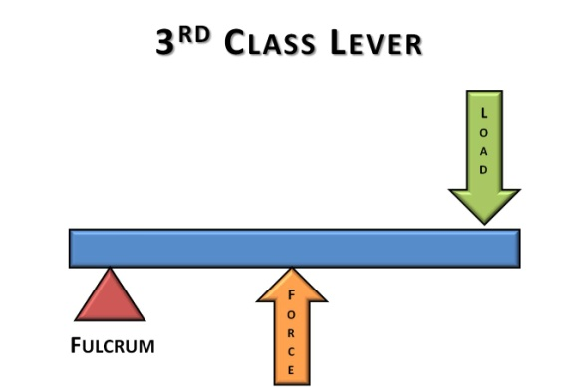
3rd Class Lever
The Effort force is between the Fulcrum and Resistance
Increases the distance through which the force moves, which causes the resistance to move farther and faster

Slide 6
Work and Efficiency
Energy cannot be created or destroyed.
No simple machine can do more work than the person using it supplies.
It CAN increase or change the direction of the force.

Slide 7
Work and Efficiency (cont.)
Work Input- work put into a machine by its user
Work Output- work done by a machine against the resistance
Efficiency- how well a machine performs
Efficiency = work output X 100%
work input

Slide 8
Mechanical Advantage
People use simple machines to make work easier.
Mechanical Advantage- factor by which a machine multiplies the effort force.
MA = Resistance Force
Effort Force

Slide 9
Mechanical Advantage (cont.)
Effort Arm- The distance between the fulcrum and the effort force of a lever.
Resistance arm- The distance between the fulcrum and the resistance force of a lever.
MA = effort arm
Resistance arm

Slide 10
Pulley
Pulley- a simple machine made of a rope, chain, or belt wrapped around a wheel.
Single fixed pulley – changes the direction of the force. MA= 1. Use this type of pulley to lift a heavy object by pulling down instead of lifting up.
Fixed Pulley- is attached at the top. The wheel is free to spin, but it cannot move up or down
Moveable Pulley- when effort is applied, the entire pulley and the object attached will rise.
MA= 2. Needs only half the force to lift it.

Slide 11
Pulley (cont.)
Pulley system-
Block and Tackle

